Slide 1
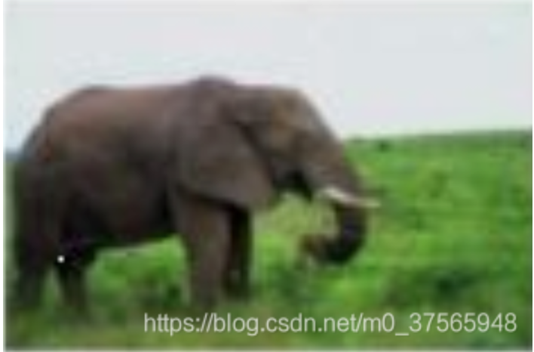
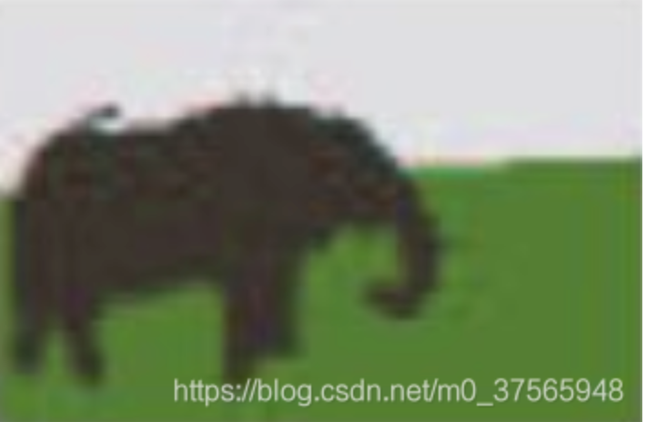
Multiple Instance Learning
在多示例学习中，训练集由一组具有分类标签的多示例包(bag)组成 ，每个多包(bag)含有若干个没有分类标签的示例(instance)。如果多示例包(bag)至少含有一个正示例(instance)，则该包被标记为正类多示例包（正包）。如果多示例包的所有示例都是负示例，则该包被标记为负类多示例包（负包）。多示例学习的目的是，通过对具有分类标签的多示例包的学习，建立多示例分类器，并将该分类器应用于未知多示例包的预测
分割为3个区域

Slide 2
Multiple Instance Learning
在多示例中，多示例包bag (图像)的label是已知的（训练集给定的），但是，示例instance（分割区域）的label是未知的。我们的任务是，在正类多示例包bag和负类多示例包bag的基础上，建立分类器，区分正类多示例包和负类多示例包。困难之处在于，每个多示例包含有若干个示例（向量），只有多示例包（图像）的label是已知的，多示例包里面的示例（分割区域）的label是未知的。
分割为3个区域

Slide 3
Chongqing University of Technology
ATAI
Advanced Technique of Artificial Intelligence
Chongqing University of Technology
A similarity-based two-view multiple
instance learning method for classification
journal homepage: www.elsevier.com/locate/knosys
Reported by jia wang

Slide 4
Chongqing University of Technology
ATAI
Advanced Technique of Artificial Intelligence
Chongqing University of Technology
1. Introduction
2. Similarity-based two-view multiple instance learning
3. Experiments
4. Conclusion and future work

Slide 5
Introduction
MIL is originally used for drug activity prediction，its purpose is to build a learning system by learning the known and unknown molecules of pharmaceuticals,and to predict whether other new molecules are suitable for pharmaceuticals.
With the development of computer science and technology, MIL is applied more and more frequently in image classification. In image classification, MIL treats an image as a bag, and each segmentation of an image is treated as an instance

Slide 6
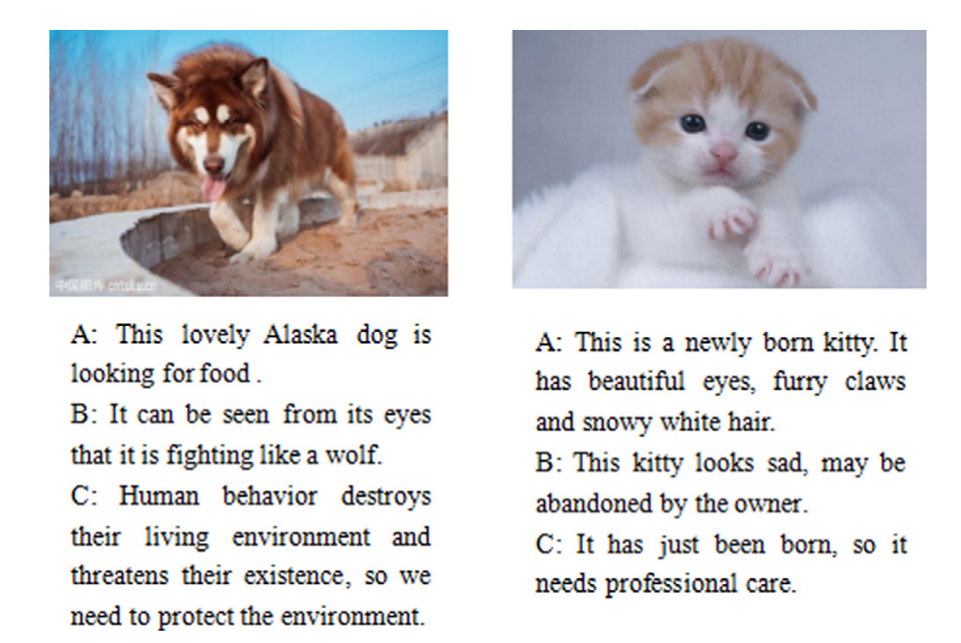
Introduction
However, we may meet the multi-instance data which consists of more than one view in practice. For example, in the image classification, in addition to image information, there are some text information in the image classification.

Slide 7
Introduction
The main contributions of our work are as follows:
We propose a new similarity-based two-view method(STMIL), based on the basic MIL method to incorporate two-view data in to a learning model, such that we can deliver a more accurate predictive classifier.
①
The results show that our method demonstrates highly competitive classification accuracy and shows less sensitivity to the labeling noise than the existing MIL methods.
②

Slide 8
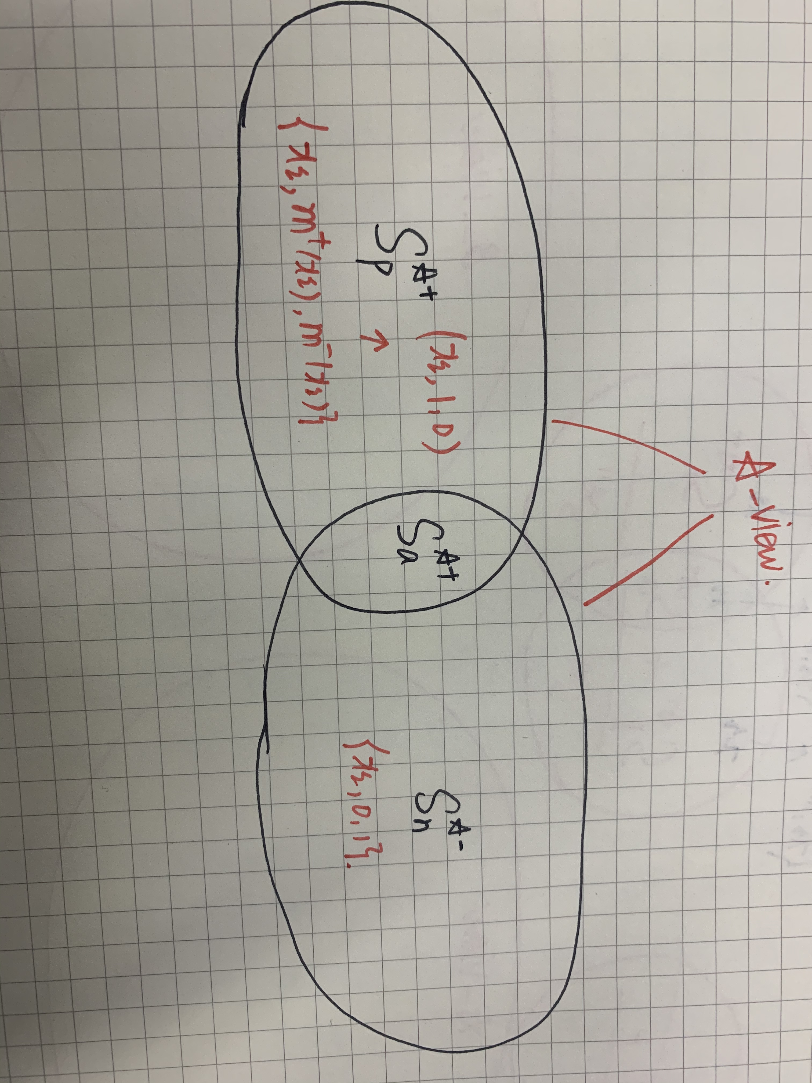
Similarity-based two-view multiple instance learning
Data model and two-view data generation

Slide 9
Similarity-based two-view multiple instance learning
Data model and two-view data generation
Given an instance x and a subset S, the similarity of x to S is defined as:
Both memberships are calculated as follows:

Slide 10
Similarity-based two-view multiple instance learning
Data model and two-view data generation
For the problem of image classification with description text,we convert the image and text into multiple instance data form using the existing methods and extract the features from the image data.
We then use SIFT algorithm
to extract feature points of the image, and use different clustering methods, (k-means,EM clustering and DBSCAN) to cluster all the extracted feature points, then construct a bag of word (BOW) descriptor for each image. We can also use the segmentation algorithms,(GrabCut and MILCut) to
divide the image into the A-view.
------→
For text feature extraction,we use the term frequency–inverse document frequency (TF-IDF) method, which is formed into B-view.
------→

Slide 11
Similarity-based two-view multiple instance learning
the training sets for the A-view and B-view.
|YA| and |YB| are the number of bags for the A-view and B_view respectively. For (BAI,YAI ), I = 1，2... |YA|, where BI denotes a bag which contains a number of instances, we utilize xi (where xi∈BI) to denote an instance of BI; YI denotes the label of the bag: if YI = 1, then at least one positive instance exists in BI,if YI = −1, then each instance in BI is negative.

Slide 12
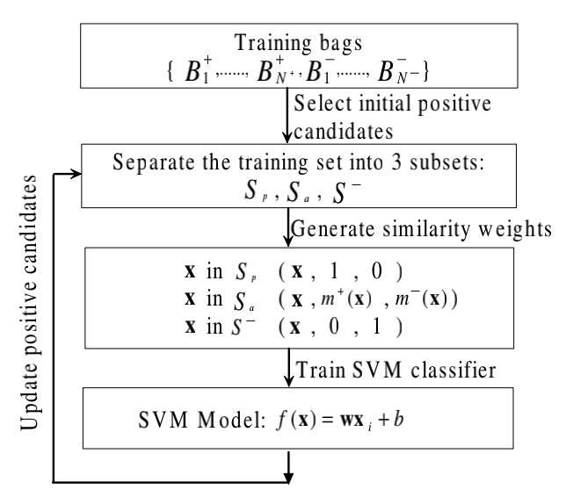
Similarity-based two-view multiple instance learning
STMIL method

Slide 13
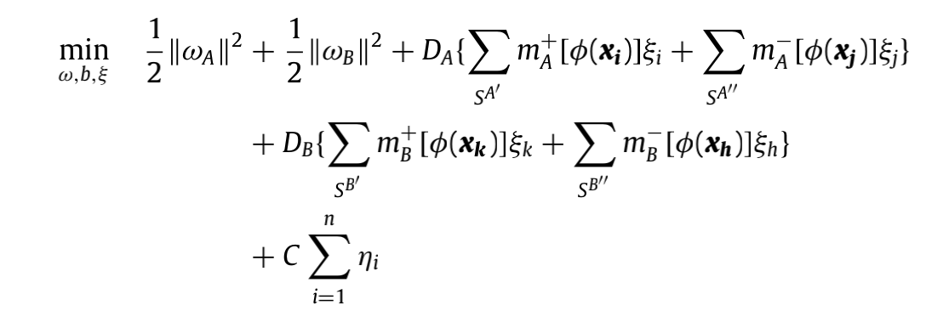
Similarity-based two-view multiple instance learning
STMIL method
In our proposed approach, suppose we train SVM on for the A-view and on for the B-view. We assume that are two hyperplanes for both views.We propose STMIL-SVM method based on our previous work on MIL.
This leads to the following minimization problem of STMIL-SVM and the formulation is given by:

Slide 14
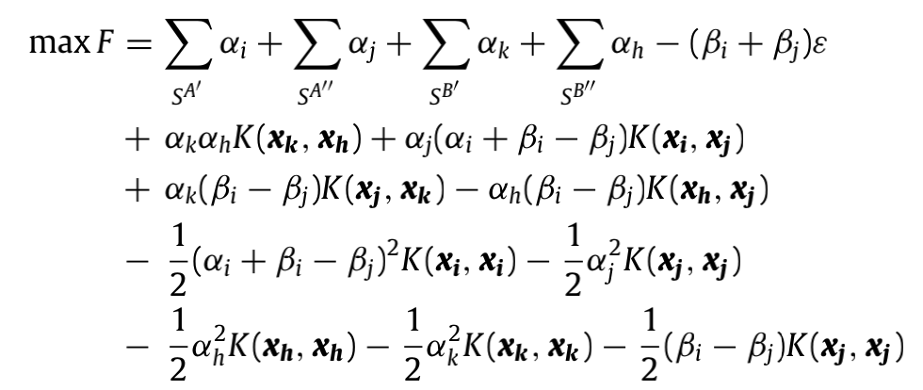
Similarity-based two-view multiple instance learning
STMIL method:Problem Solution
We solve the optimization problem by introducing the Lagrangian method, and can get Theorem 1.
We propose STMIL-SVM method based on our previous work on MIL. This leads to the following minimization problem of STMIL-SVM and the formulation is given by：

Slide 15
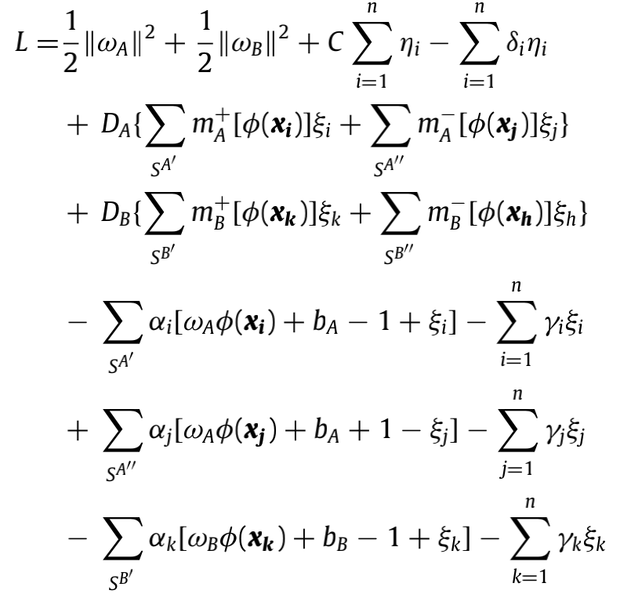
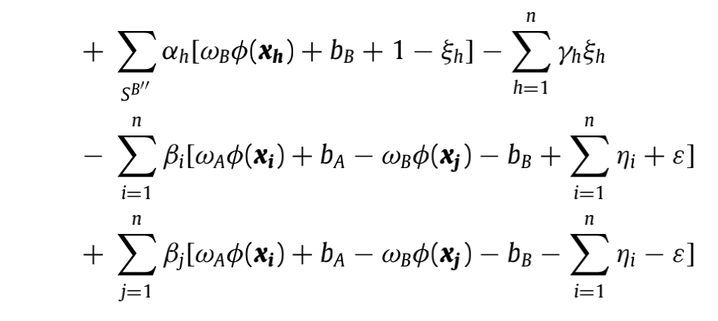
Similarity-based two-view multiple instance learning
STMIL method:Problem Solution
Proof：The optimization problem in (5) can be converted to the dual form by differentiating the Lagrangian function with the original variables ωA, ωB, ξi, ξj, ξk, and ξh.

Slide 16
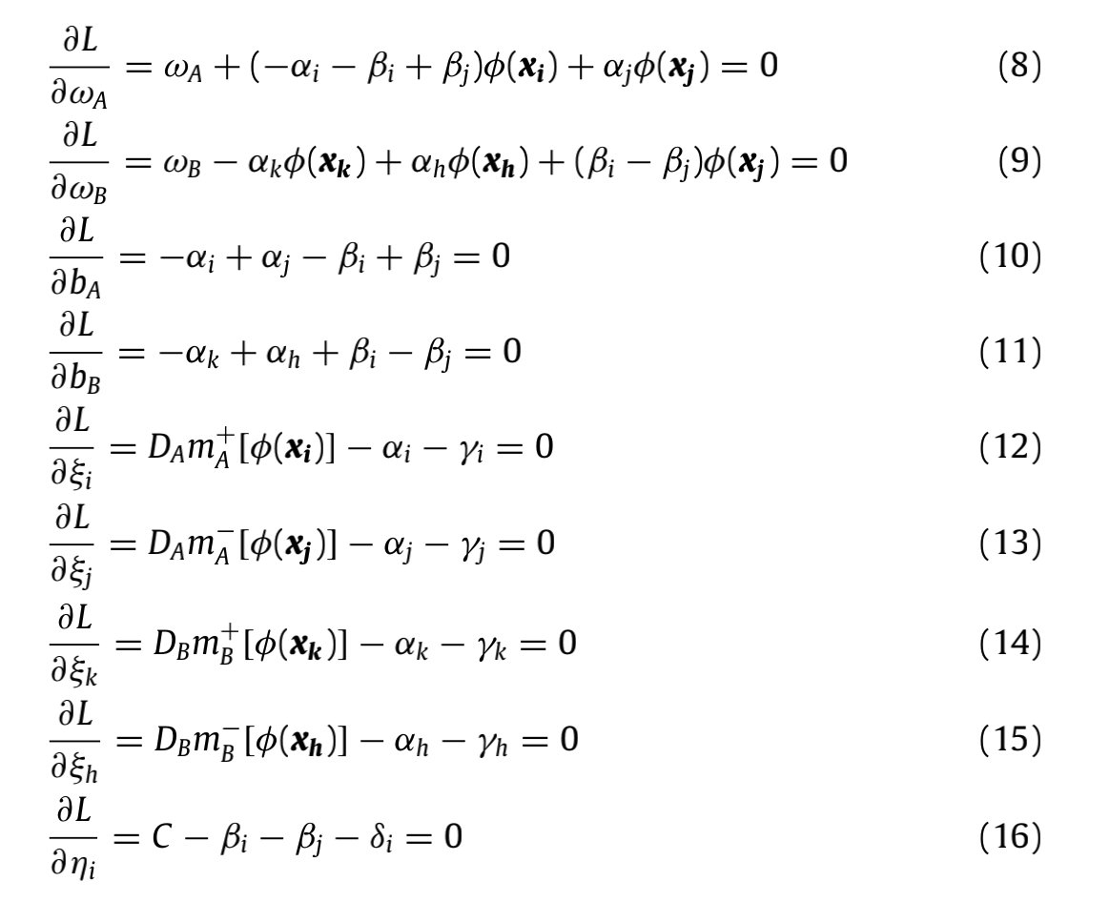
Similarity-based two-view multiple instance learning
STMIL method
We can get ωA/B according to (8) and (9) as follows:

Slide 17
Similarity-based two-view multiple instance learning

Slide 18
Experiments

Slide 19
Experiments

Slide 20
Experiments

Slide 21
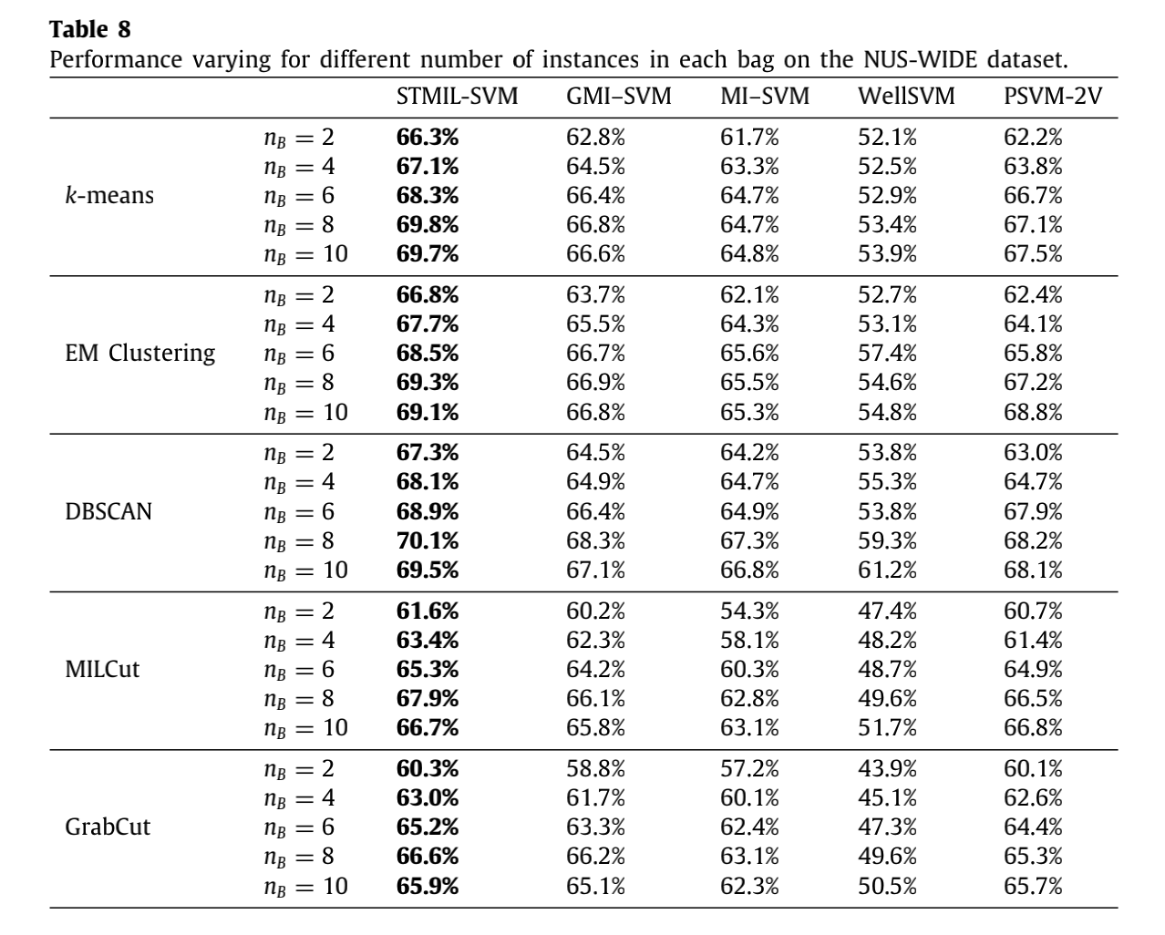
Experiments

Slide 22
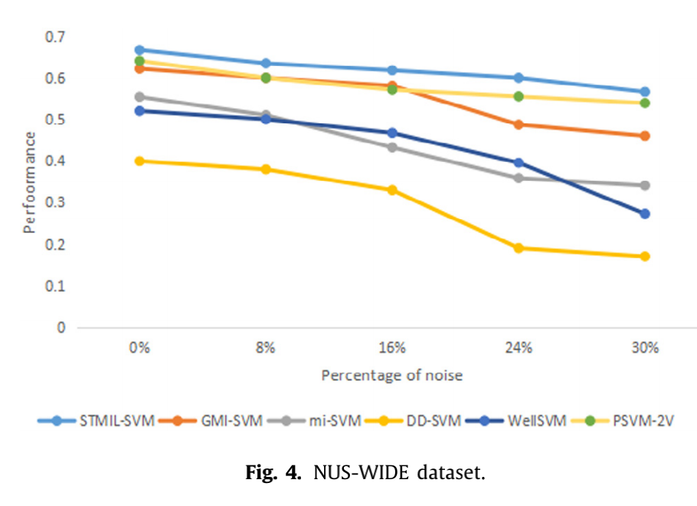
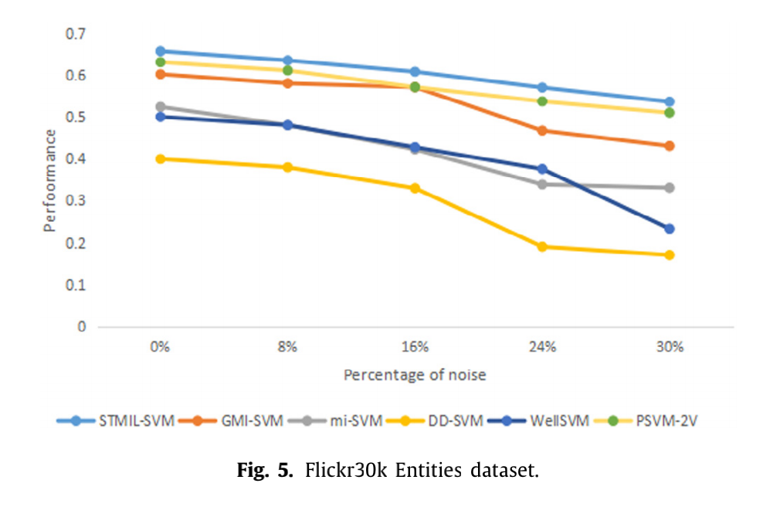
Experiments

Slide 23
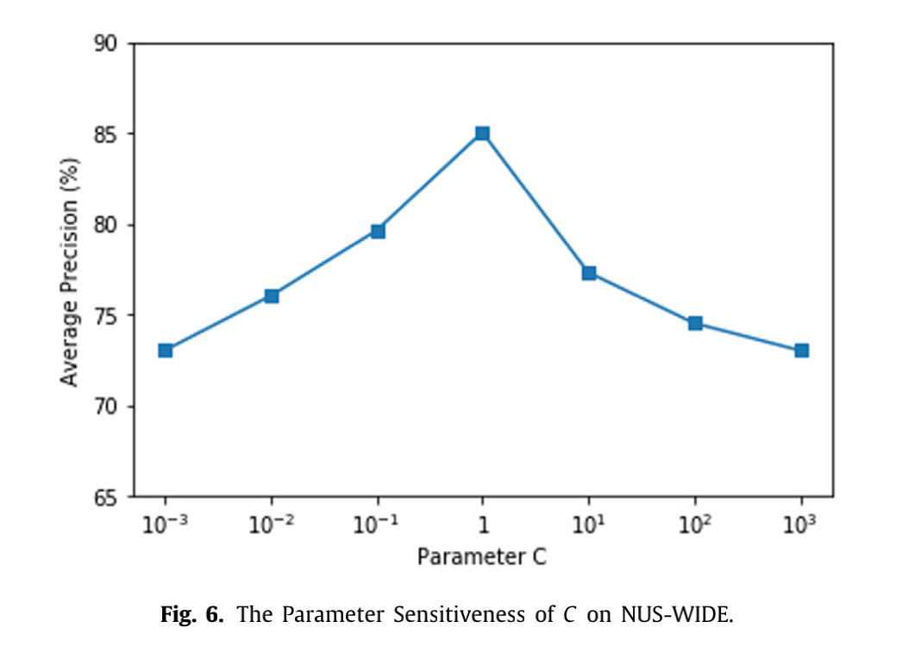
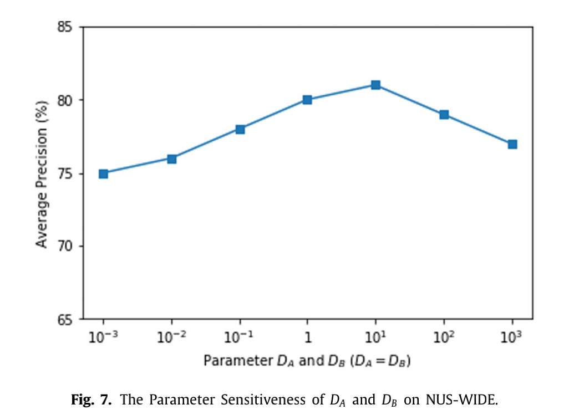
Experiments

Slide 24
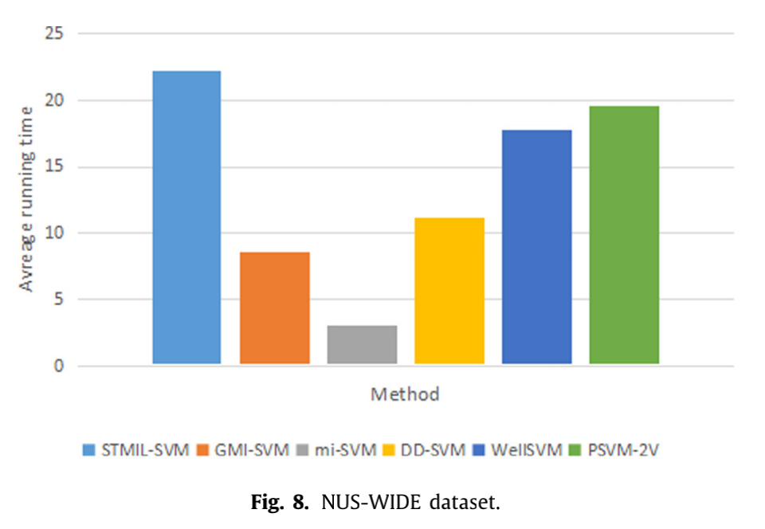
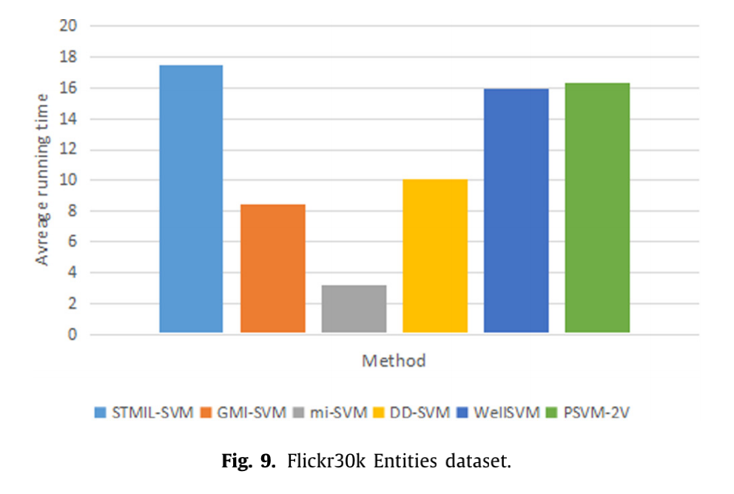
Experiments

Slide 25
Conclusion and future work
In this paper, we propose a new similarity-based two-view MIL (STMIL). We first utilize the two-view learning method to place images and text information in two views, and convert
the image classification problem into a MIL problem. We then propose the two-view MIL for image and textual classification.
We present the original STMIL-SVM problem and solve it using the Lagrangian method, In the experimental part, we use three clustering algorithms (k-means, EM clustering and DBSCAN) and two image segmentation algorithms (GrabCut and MILCut) to process the images and compare their performance.
Experiments have shown that our method has higher performance compared with other MIL methods.In the future, we will expand our approach and framework to the field of video processing and online data.

Slide 26
Thanks

